Slide 1
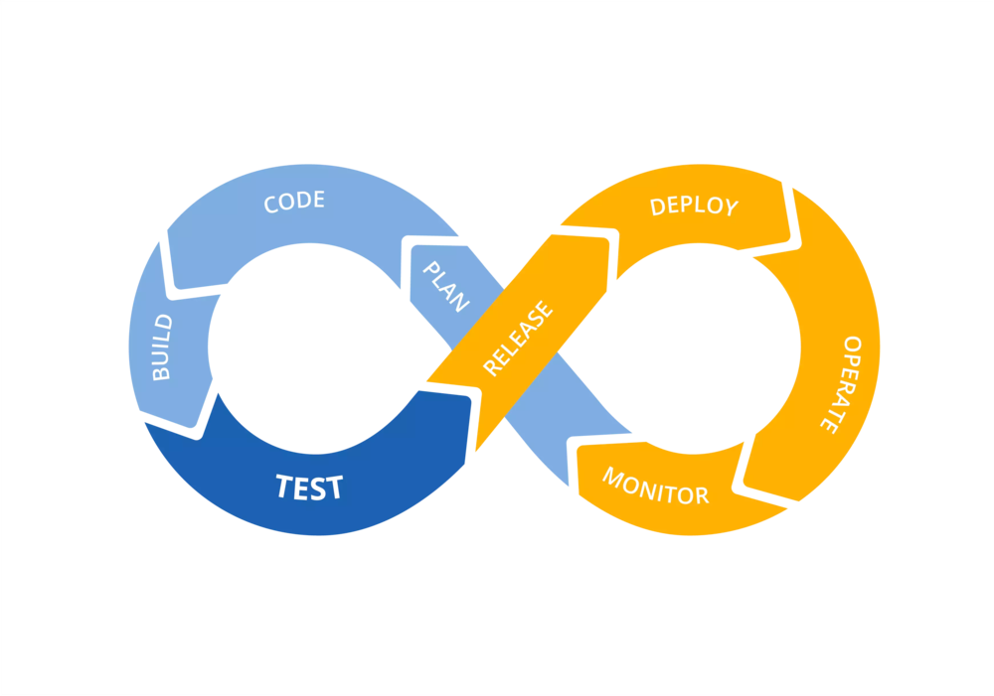
Continuous Integration and Delivery (CI/CD)

Slide 2

WHAT IS CI/CD ?
The practice of automating the integration of code changes from multiple contributors into a single software project
Continuous integration leads to continuous deployment allowing us to deliver software more rapidly
Notes:
This is the Jenkins Dashboard.
2

Slide 3
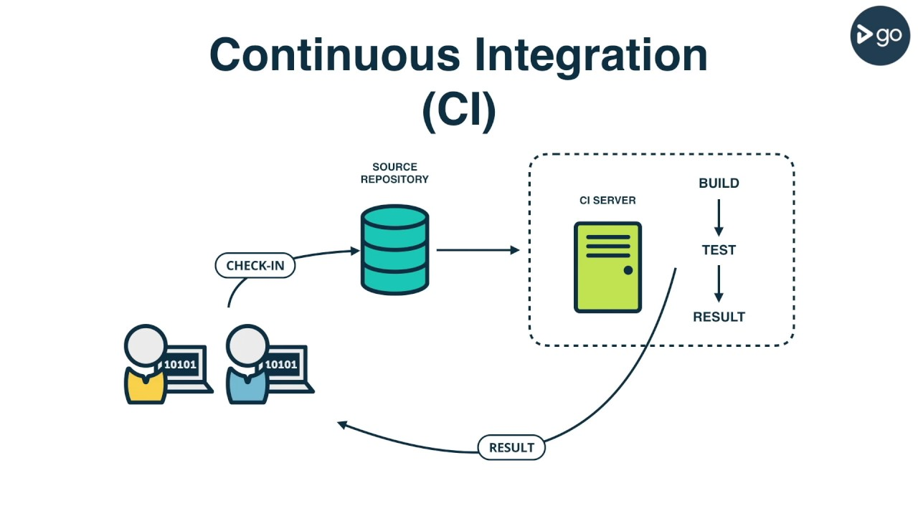

Slide 4
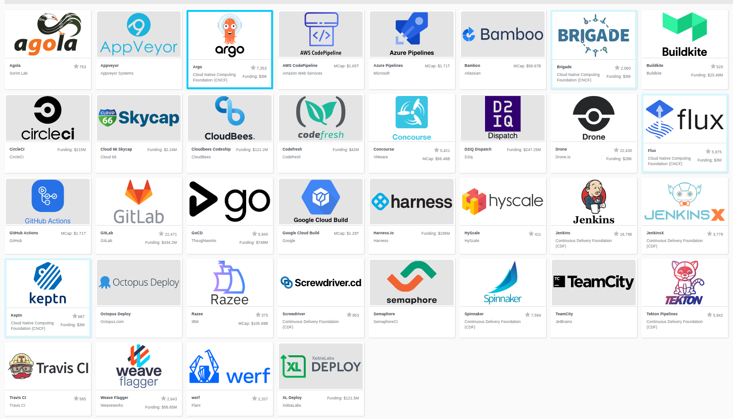
CI/CD TOOL OPTIONS
Source : landscape.cncf.io
Notes:
This is the Jenkins Dashboard.
3

Slide 5

Open Source Continuous Integration Server

Slide 6
INSTALLATION
Prerequisites :
Create a centos7 VM with Vmware/Virtualbox
Log in to your machine as root (or user with sudo privileges)
Installing Jenkins :
1. Jenkins is a java application, so you need to install java
$ sudo yum install java-1.8.0-openjdk-devel
2. add Jenkins repository
$ wget -O /etc/yum.repos.d/jenkins.repo https://pkg.jenkins.io/redhat/jenkins.repo
$ sudo rpm --import https://jenkins-ci.org/redhat/jenkins-ci.org.key

Slide 7
INSTALLATION
3. Install and start Jenkins
$ sudo yum install jenkins
$ sudo systemctl start jenkins
$ sudo systemctl status jenkins
$ sudo systemctl enable jenkins
4. Allow Jenkins port to be accessible from outsite the VM
$ sudo firewall-cmd --permanent --add-port=8080/tcp
$ sudo firewall-cmd –reload
5. Open http://your_ip_or_domain:8080 and setup your jenkins
You can find more at link below :
https://www.jenkins.io/doc/book/installing/linux/

Slide 8
WHAT IS JENKINS?
Monitors executions of repeated jobs
Used primarily for continuously building and testing software projects, i.e. “Continuous Integration” or “CI”
Previously known as “Hudson”
https://jenkins.io/

Slide 9





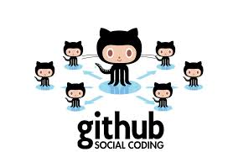


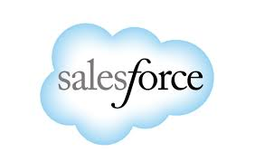




WHO USES JENKINS?
Notes:
8

Slide 10
WHY USE JENKINS?
Free & Open Source
Immediate feedback on broken builds
No building from dev machines and manually copying files
Automated build, test, deploy, and practically anything you can do in the command line.
Automated test execution and feedback

Slide 11
PLUG-INS
Over 600 plug-ins available for customization
Examples:
JIRA
Ant
Maven
JUnit
Javadoc
SSH
MSBuild
NUnit
PowerShell
Email Notifications
https://wiki.jenkins-ci.org/display/JENKINS/Plugins

Slide 12
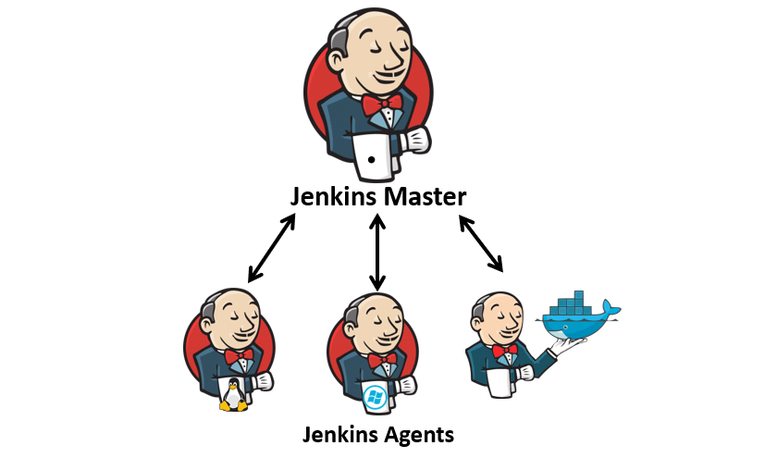
DISTRIBUTED BUILDS
Jenkins architecture is fundamentally "Master-Agent“
The master is designed to do co-ordination and provide the GUI and API endpoints, and the Agents are designed to perform the work

Slide 13
QUESTIONS?

Slide 14
JENKINS PIPELINE
A continuous delivery pipeline is an automated expression of your process for getting software from version control right through to your users and customers

Slide 15
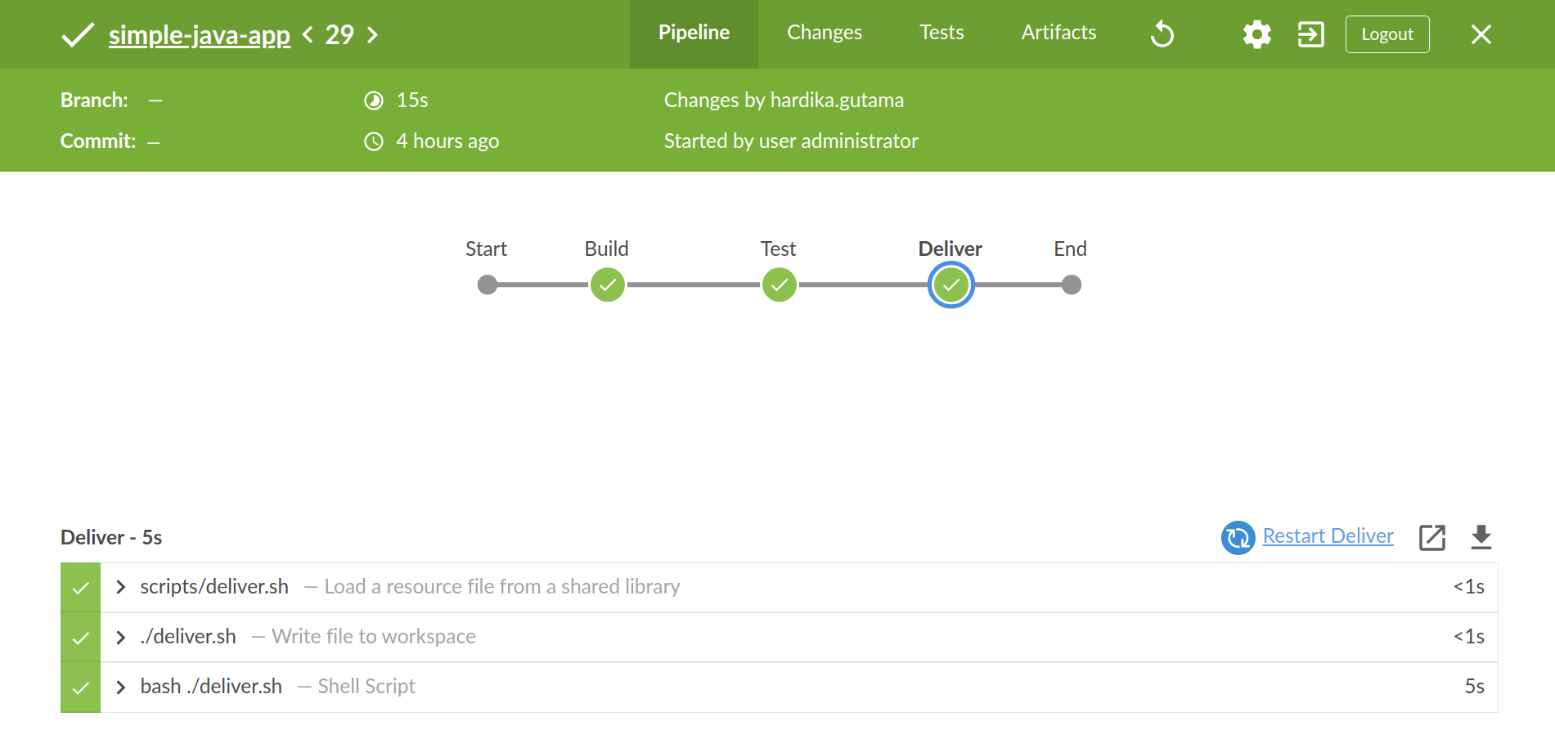
JENKINS PIPELINE

Slide 16
Jenkinsfile (Declarative Pipeline)
pipeline {
agent any
stages {
stage('Build') {
steps {
sh 'makemvn -B -DskipTests clean package'
}
}
stage('Test'){
steps {
sh 'mvn test'
}
post {
always {
junit 'target/surefire-reports/*.xml'
}
}
}
stage(‘Deliver') {
steps {
sh './jenkins/scripts/deliver.sh'
}
}
}
}

Slide 17
QUESTIONS?

Slide 18
EXAMPLE 1
Build a java app with maven
1. Clone https://github.com/hrdkgtm/simple-java-maven-app.git to your local machine
2. Open your jenkins and create pipeline job
The official tutorial from Jenkins Documentation :
https://jenkins.io/doc/tutorials/build-a-java-app-with-maven/

Slide 19
EXPECTED ERRORS
In this exercise, we might face errors from the build.
This is just a maven behavior where it needs to download a lot of dependencies at the initial run.
We can simply ignore the error and rebuild from jenkins. Once the job succeded, maven will no longer throw those errors since the dependencies are already downloaded and installed
Example :
[ERROR] Failed to execute goal org.apache.maven.plugins:maven-compiler-plugin:2.3.2:compile (default-compile) on project my-app: Execution default-compile of goal org.apache.maven.plugins:maven-compiler-plugin:2.3.2:compile failed: Plugin org.apache.maven.plugins:maven-compiler-plugin:2.3.2 or one of its dependencies could not be resolved

Slide 20
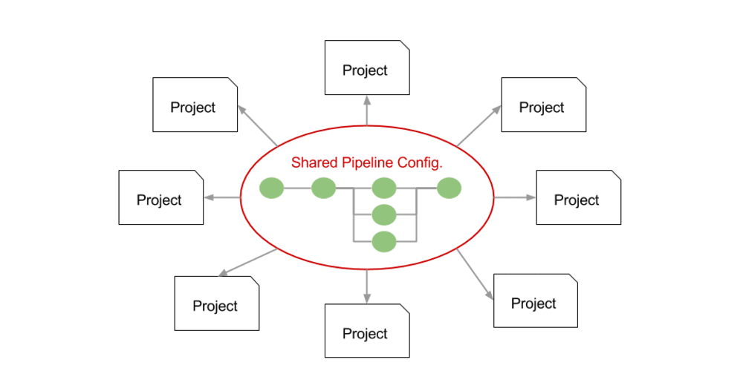
CENTRALIZED PIPELINE
As Pipeline is adopted for more and more projects in an organization, common patterns are likely to emerge. Oftentimes it is useful to share parts of Pipelines between various projects to reduce redundancies and keep code "DRY"

Slide 21
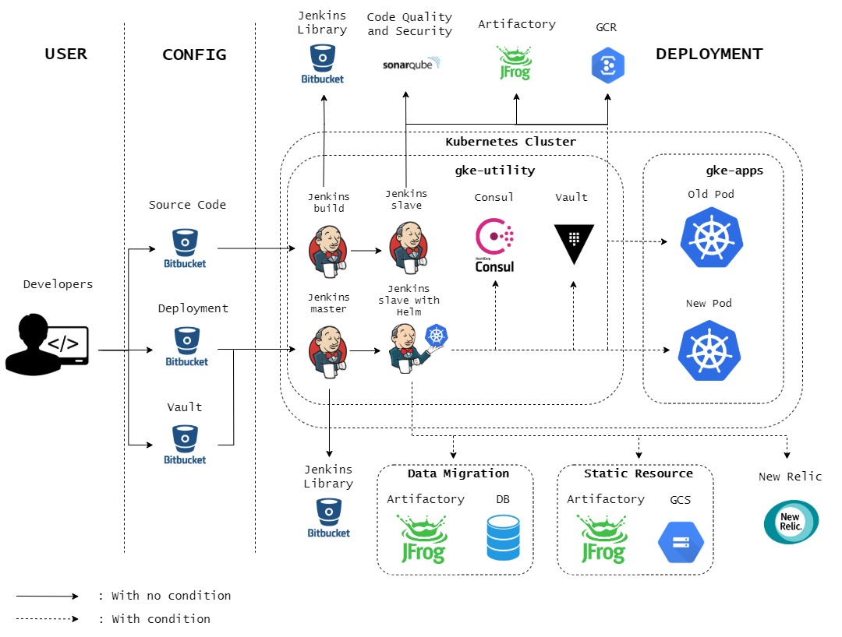
CI/CD AT BLIBLI.COM

Slide 22
EXAMPLE 2
Implement Jenkins shared library
1. Clone https://github.com/hrdkgtm/simple-java-maven-app.git to your local machine
2. Configure global library pipeline from Jenkins UI
Manage Jenkins > Configure System > Global Pipeline Library
3. Update your Jenkinsfile in maven repo (example 1) to use library from https://github.com/hrdkgtm/future-jenkins-library.git
More info :
https://jenkins.io/doc/book/pipeline/shared-libraries/

Slide 23
QUESTIONS?

Slide 24
TASK 1
Deploy using a docker agent, like the official tutorial in Jenkins documentation.

Slide 25
TASK 2
Deploy the java maven application (example 1) to targeted VM using shared library

Slide 26
QUESTIONS?

